Slide 1
CRUD operation REST Services
Swagger 2 Documnetation

Slide 2
SpringBootApplication
import org.slf4j.Logger;
import org.slf4j.LoggerFactory;
import org.springframework.boot.SpringApplication;
import org.springframework.boot.autoconfigure.SpringBootApplication;
import springfox.documentation.swagger2.annotations.EnableSwagger2;
@SpringBootApplication
@EnableSwagger2
public class AccessingDataJpaApplication {
private static final Logger log = LoggerFactory.getLogger(AccessingDataJpaApplication.class);
public static void main(String[] args) {
SpringApplication.run(AccessingDataJpaApplication.class);
}
}

Slide 3
@RestController
public class CustomerController {
@Autowired
private CustomerService service;
@GetMapping("/getCustomerById/{id}")
public Optional<Customer> getCustomerById(@PathVariable("id") Long id) {
return service.getCustomerById(id);
}
@GetMapping("/allrecord")
public Iterable<Customer> getAllCustomer() {
return service.getAllCustomer();
}
@PostMapping("/addCustomer")
public @ResponseBody String addCustomer(@RequestBody Customer customer) {
service.addCustomer(customer);
return " saved ";
}
@DeleteMapping("/deleteCustomerById/{id}")
public void deleteCustomer(@PathVariable("id") Long id) {
service.deleteCustomerByid(id);
}
@PutMapping("/updateCustomer/{id}")
public void updateCustomer(@RequestBody Customer newCustomer, @PathVariable("id") Long id) {
service.updateCustomer(newCustomer, id);
}
}

Slide 4
@Service
public class CustomerService {
@Autowired
private CustomerRepository repository;
public Optional<Customer> getCustomerById(Long id) {
return repository.findById(id);
}
public Iterable<Customer> getAllCustomer() {
return repository.findAll();
}
public String addCustomer(@RequestBody Customer customer) {
repository.save(customer);
return " saved ";
}
public String deleteCustomerByid(Long id) {
repository.deleteById(id);
return "deleted";
}
public String updateCustomer(Customer newCustomer ,Long id) {
Customer customer = repository.findById(id).get();
customer.setAddress(newCustomer.getAddress());
customer.setFirstName(newCustomer.getFirstName());
customer.setLastName(newCustomer.getLastName());
repository.save(customer);
return "updated";
}
}

Slide 5
import java.util.List;
import org.springframework.data.repository.CrudRepository;
import com.example.accessingdatajpa.model.Customer;
public interface CustomerRepository extends CrudRepository<Customer, Long> {
List<Customer> findByLastName(String lastName);
Customer findById(long id);
public Iterable<Customer> findAll() ;
}

Slide 6
@Entity
public class Customer {
@Id
@GeneratedValue(strategy=GenerationType.AUTO)
private Long id;
private String firstName;
private String address;
private String lastName;
protected Customer() {}
public Customer(String firstName, String lastName) {
this.firstName = firstName;
this.lastName = lastName;
}
public Customer(String firstName, String lastName,String address) {
this.firstName = firstName;
this.lastName = lastName;
this.address = address;
}
public String getAddress() { return address; }
public void setAddress(String address) { this.address = address; }
public void setId(Long id) { this.id = id; }
public void setFirstName(String firstName) { this.firstName = firstName; }
public void setLastName(String lastName) { this.lastName = lastName; }
private String lastName;
public Long getId() { return id;}
public String getFirstName() {return firstName;}
public String getLastName() { return lastName;}
}

Slide 7
Swagger2 Configuration
1. Entry in pom.xml file
<dependency>
<groupId>io.springfox</groupId>
<artifactId>springfox-swagger2</artifactId>
<version>2.9.2</version>
</dependency>
<dependency>
<groupId>io.springfox</groupId>
<artifactId>springfox-swagger-ui</artifactId>
<version>2.9.2</version>
</dependency>
2. entry in application.properties file
spring.mvc.pathmatch.matching-strategy=ant-path-matcher
3. @EnableSwagger2
public class AccessingDataJpaApplication {

Slide 8
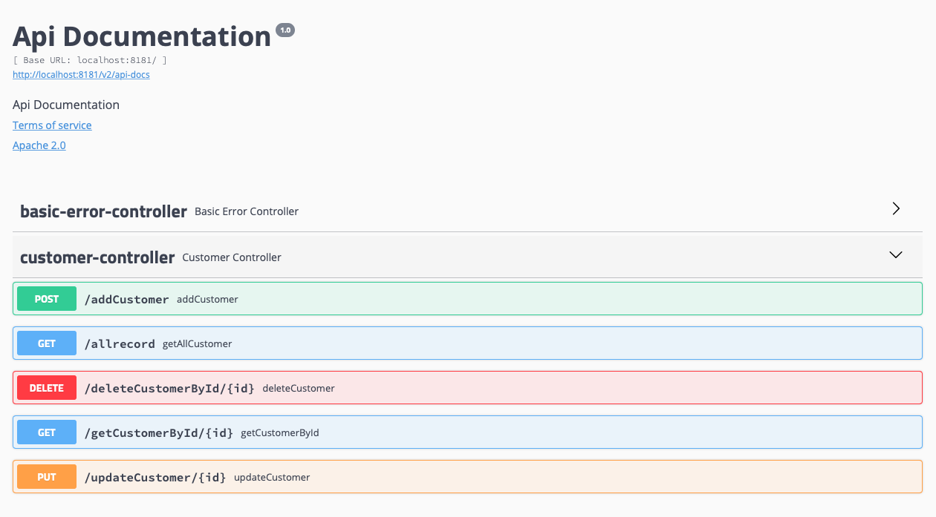
http://localhost:8181/swagger-ui.html#/

Slide 9
Thanks You

